Slide 1
Getting Started with Mendix Project
Daniela Field
Senior Solutions Consultant

Slide 2

Agenda
The Agile Process
The Mendix Project Structure
Team Structure
Project Security

Slide 3
Agile Process
Notes:
Use for this part the Mendix sales slide deck or custom created slide deck introducing Mendix

Slide 4
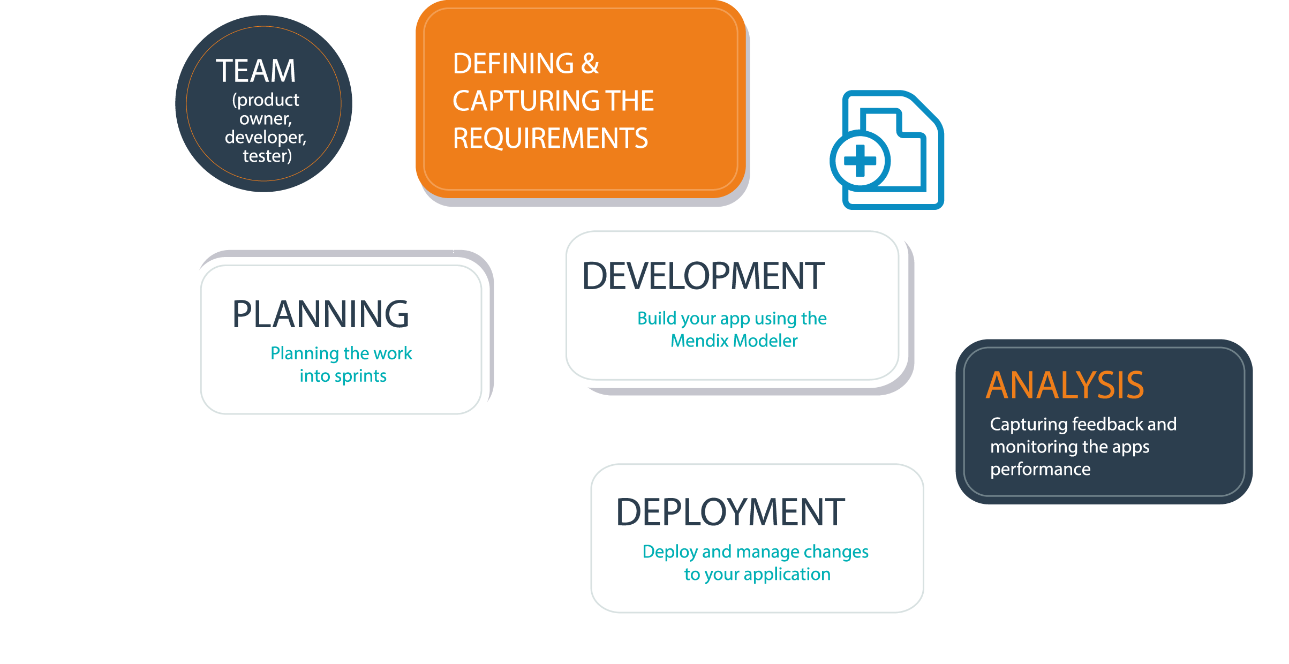

Slide 5

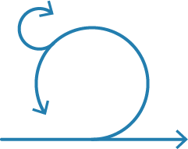
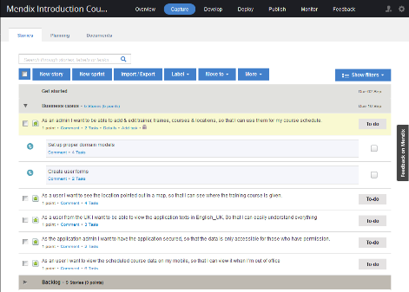
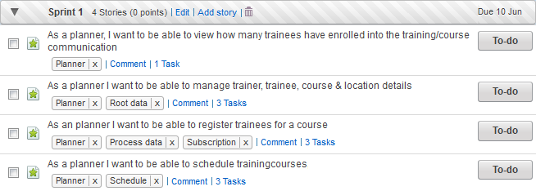
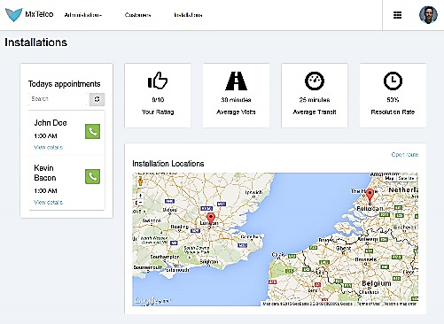

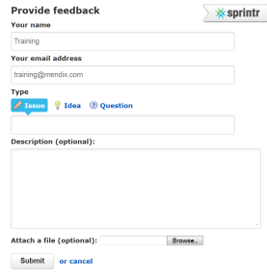


Agile Process
Team
Daily stand up
Product backlog
Sprint backlog
Product increment
Sprint
1-2 weeks
Product owner
User
Feedback
Notes:
The agile process connected to the features in the Mendix platform.
Use this slide for discussion of the Agile knowledge.
Don’t take more then ½ hour for this slide, if you aren’t aware of that, it’ll be 5 o’clock before you know!!

Slide 6
Project Structure
Notes:
Use for this part the Mendix sales slide deck or custom created slide deck introducing Mendix

Slide 7




Mendix App Project Structure
Collaborate
Invite Team
Manage Stories
Feedback
Documents
Develop
Team Server
Planning Tools
Deploy
Environments
Mobile App Stores
App Services
Operations
Metrics
Alerts
Logs
Back Ups
Settings
General
Security
API Keys

Slide 8
Mendix App Project Structure
Collaborate
Invite Team
Manage Stories
Feedback
Documents
Develop
Team Server
Planning Tools
Deploy
Environments
Mobile App Stores
App Services
Operations
Metrics
Alerts
Logs
Back Ups
Settings
General
API Keys
Security

Slide 9
Mendix App Project Structure
Collaboration
Invite Team
Manage Stories
Feedback
Documents
Development
Team Server
Planning Tools
Deployment
Environments
Mobile App Stores
App Services
Operations
Metrics
Alerts
Logs
Back Ups
Settings
General
Security
API Keys
Burndown Charts
Notes:
How can we shocase this better? Screenshots?

Slide 10
Demo

Slide 11
Team Structure & Security
Notes:
Use for this part the Mendix sales slide deck or custom created slide deck introducing Mendix

Slide 12
Roles and Project Permissions
SCRUM Master
Business Engineer
Product Owner
Performance Engineer/Tester
Application Operator
End-User
Most Permissions
Fully Granular and Customizable
Least Permissions

Slide 13
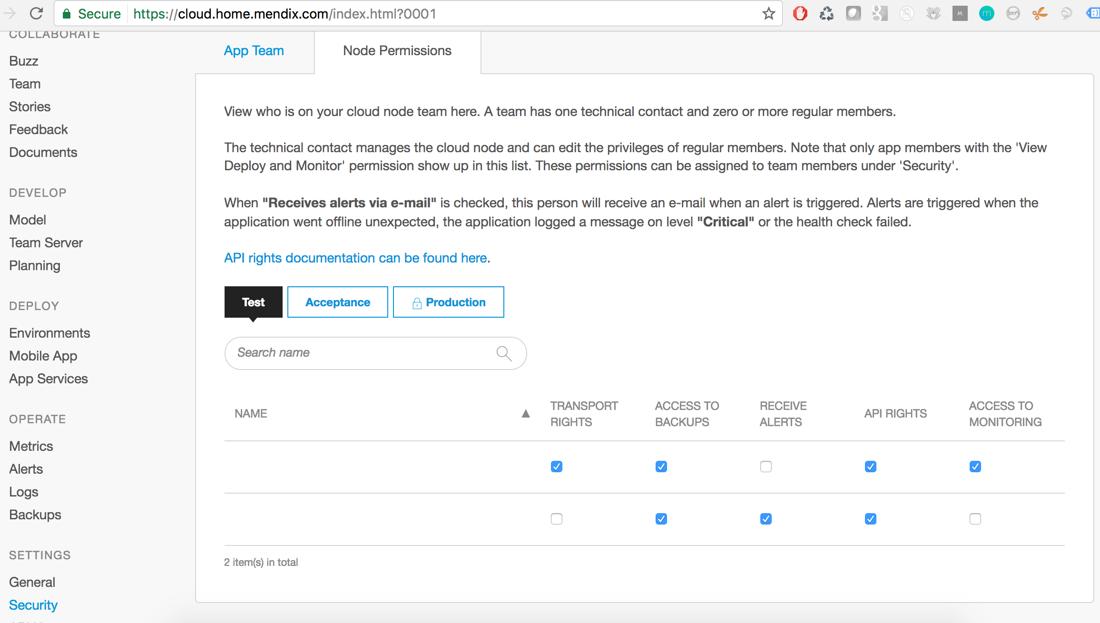
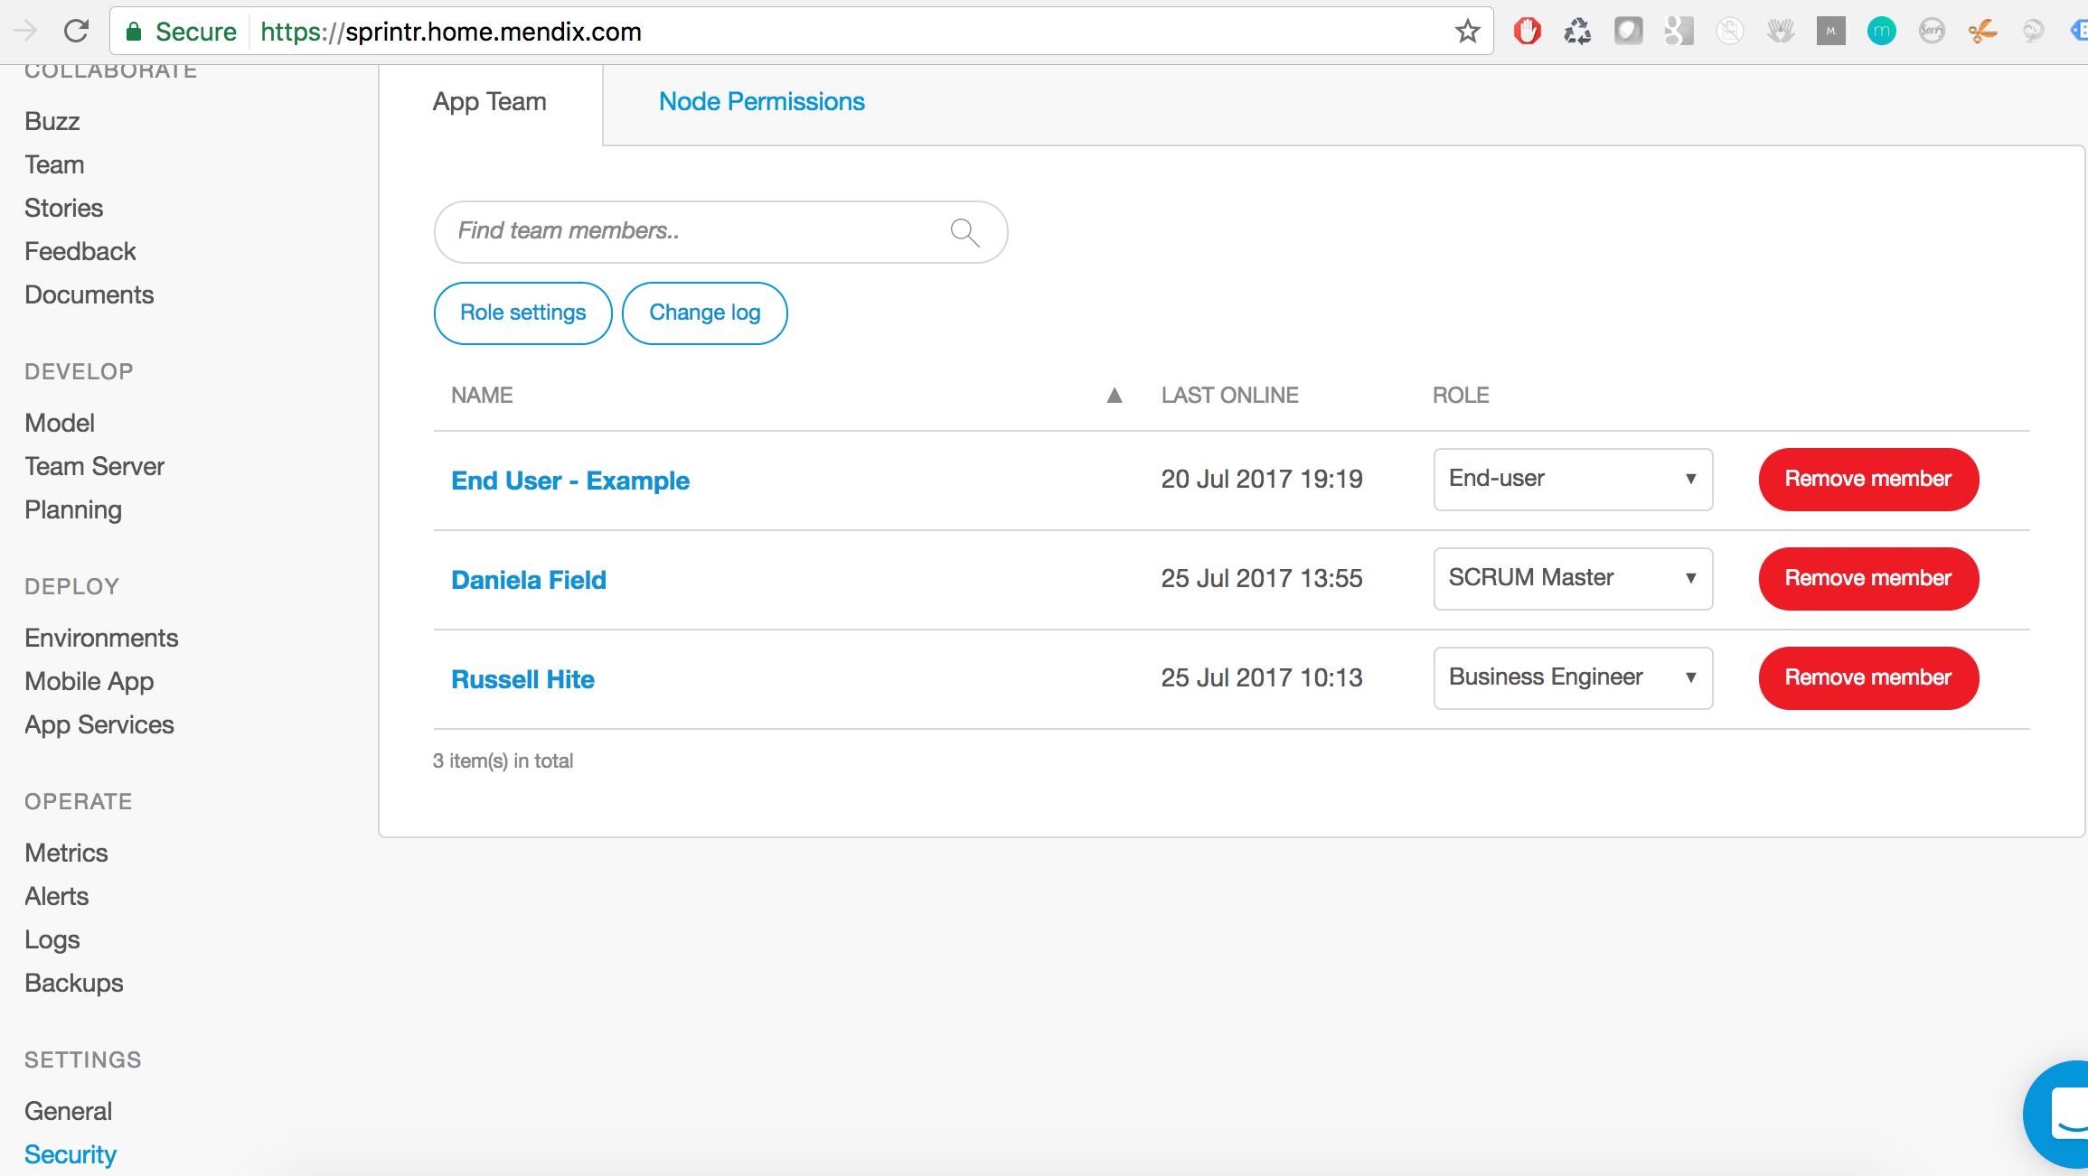
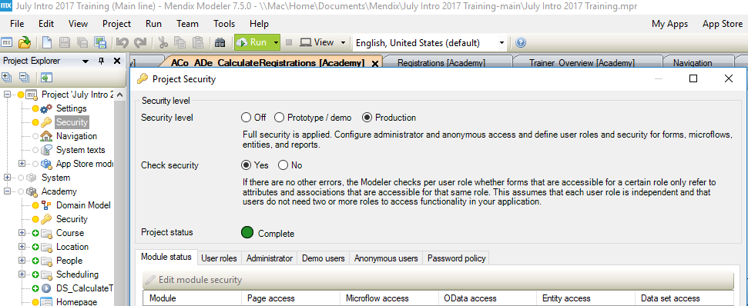
Application vs Project vs Node Security
Project Security
Node Security
Application Security
Notes:
Going to add annimation here to show each one separately

Slide 14
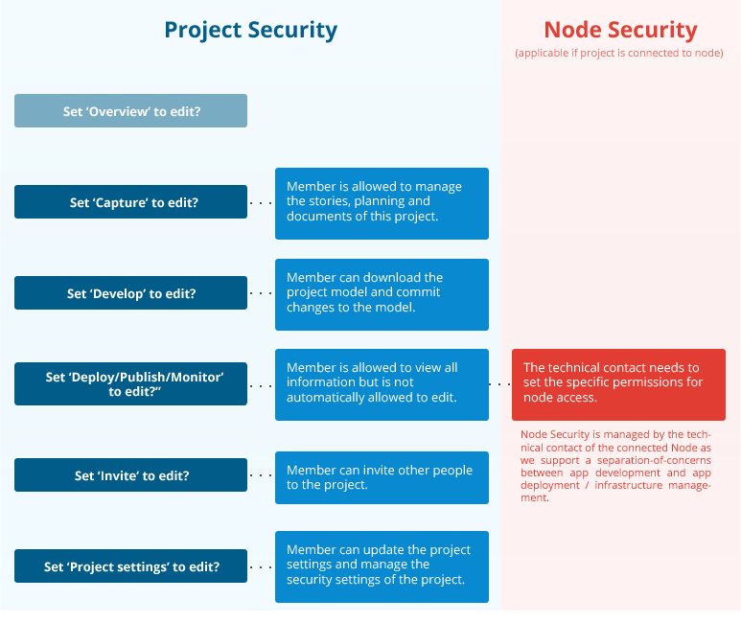

Slide 15
Demo

